Slide 1
DESIGN OF A SMART FIRE DETECTION SYSTEM
DAVID GOSLEE, ISRAEL AKINSOYINU, DEDRICK MCCOY

Slide 2
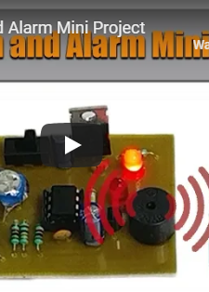
PROJECT INSPIRATION
This was a mini fire detection system found on Nevon Projects.
Detects a fire using a thermistor.
Simple LED and alarm notification.
A good base line device but leaves a lot to be desired.

Slide 3
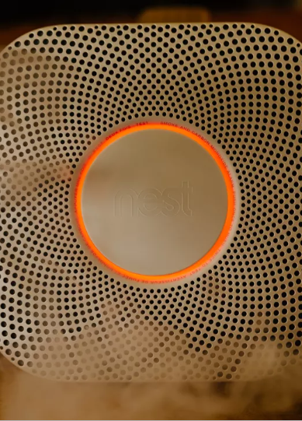
NEST SMART DETECTOR
This is the Nest Project smart fire detector.
Uses a photoelectric sensor and a split-spectrum sensor to detect possible fire threats.
Is equipped with its own app that alerts users when an issue arises.
Can be deactivated via app interface if there is a false alarm.
Prices range from 50 through 180 dollars

Slide 4
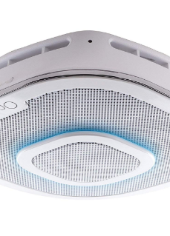
ALEXA ENABLED SMOKE DETECTOR AND CO MONITOR
This is another product that is similar in nature to the project we envision.
Uses photoelectric sensors to detect possible fires.
Comes equipped with a Carbon Monoxide monitoring system.
Compatible with all apple products.
Alexa enabled and uses First Alert OneLink app to notify users.
Prices range from 200 – 270 dollars.

Slide 5
SMART FIRE DETECTION SYSTEM OBJECTIVES
The project goal is to create a smart fire detection system that can be implemented for commercial and in home use.
Determine the fire location i.e. room, floor, or stair well and notify dispatch operators and alert building occupants.

Slide 6
DESIGN REQUIREMENTS
911 call that notifies dispatch of a potential fire and its location within the building.
Detect the temperature of the fire (for flash point).
Monitor Carbon Monoxide levels.
Sms warning message for building occupants.
Must provide output signals for PPE systems (i.e. sprinklers, automatic doors, etc.).
The time from the detector’s issuing a fire alarm signal to the controller’s receiving should be controlled within the 10 seconds (GB4717-2005 Fire Alarm Control Units)
If any module in the system fails, fire alarm controller should detect the fault in 100 seconds.
Fire Detector should mount to existing detectors base mount.

Slide 7
Design Constraints
Voice alarm notification for occupants of structure.
Detector cost should not be more than 200 dollars.
Wireless nodes must be no more than 60 feet apart.

Slide 8
National Industrial Standards
The initiation function provides the input signal to the system (NFPA 101, 9.6.1.7).
The notification function is the means by which the system advises that human action is required in response to a particular condition (NFPA 101, 9.6.1.7).
The control function provides outputs to control building equipment to enhance protection of life (NFPA 101, 9.6.1.7).
Occupant notification shall be by means of voice announcements (NFPA 101, 12.3.4).
Fire alarm circuits shall be installed in a neat workmanlike manner (NFPA 70 Art. 760.24).
Cables and conductors installed exposed on the surface of ceilings and sidewalls shall be supported by the building structure in such a manner that the cable will not be damaged by normal building use (NFPA 70 Art. 760.24).
Smoke detector must be replaced every ten years in accordance to Maryland Smoke Alarm Law.
The smoke alarm requirements for existing older homes are based upon when the house was built.
The Law heavily emphasises the use of sealed smoke alarms with long life batteries and silence/hush buttons.
Any new home in Maryland constructed after January 1, 1989 required at least one hardwired electric smoke alarm on every level of the home, including the basement.
The units must be interconnected in order that activation of any one of the required smoke alarms resulted in the sounding all of the required smoke alarms.
The time from the detector’s issuing a fire alarm signal to the controller’s receiving should be controlled within the 10 seconds (GB4717-2005 Fire Alarm Control Units)

Slide 9
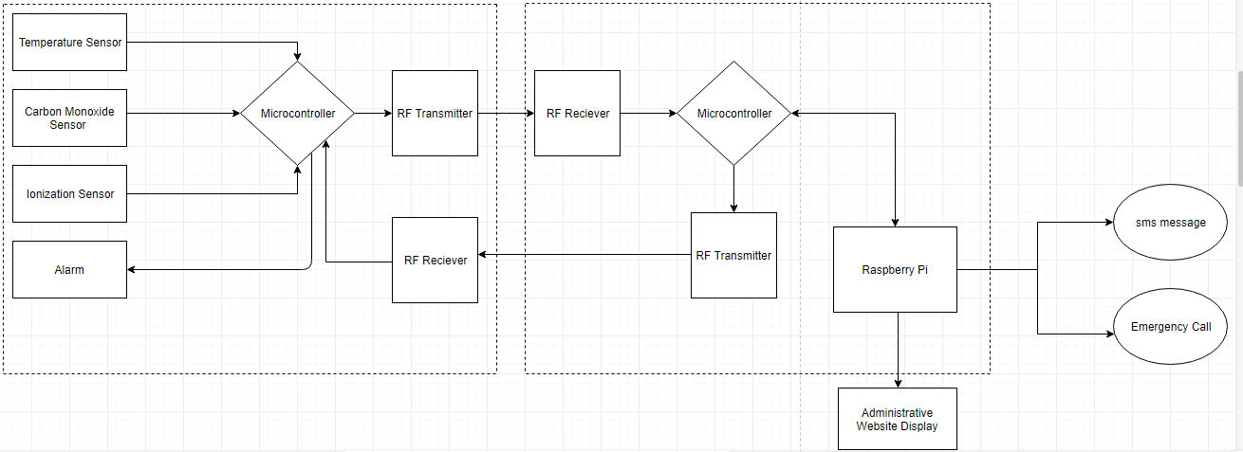
System Diagram

Slide 10
Implementation Plan
Task 1: Sensor Design
1.1: Design program for Temperature Sensor.
1.2: Design program for Carbon monoxide sensor.
1.3: Design program for Ionization sensor.
1.4: Interface arduino with all three sensors.
1.5: Test sensor interface with arduino.
1.6: Design PCB for transmitter
1.7: Design PCB for receiver
1.8: Test PCB design for receiver
1.9: Test PCB design for transmitter
Task 2: Wireless Sensor Network Design
2.1: Design arduino and RF transmitter interface.
2.2: Design program for microcontroller and RF transmitter.
2.3 Design arduino and RF receiver interface.
2.4: Program interface with arduino and RF receiver.
2.5: Interface Raspberry Pi for receiver interface.
2.6: Design program for sensor data processing and allocation.
2.7: Test Wireless Sensor Network.

Slide 11
Implementation Plan (continued)
Task 3: Website Design
3.1: Design background and layout of website.
3.2: Design login for administrator and user access.
3.3: Program a grid that will establish compartments for rooms.
3.4: Design program that will interface raspberry pi and website.
3.5: design a program that will pair node ID with corresponding room on grid plan.
3.6: Program grid to highlight room where potential fire occurs.
3.7: Test interface with website with external display and display webpage.
Task 4: Automated Phone Call System Design
4.1: Setup pivlo account and install software on raspberry pi.
4.2: Design Virtual Alert message for each ID node.
4.3: Design program that will correlate room ID numbers to specific automated dispatch message.
4.4: Program Pi for sms data transmission.
Task 5: Design Warning Message Database
5.1: Program sms message corresponding to proper node ID.
5.2: Design database for building occupant phone number allocation.
5.3: Design a program that will send link to webpage.
5.4: Test sms warning system.

Slide 12
Implementation Plan (cont.)
Task 6: System Assembly and Testing
6.1: Assemble entire system.
6.2: Test full platform with nodes placed in their appropriate positions.
6.3: Test warning systems and ensure they give proper threat location.

Slide 13
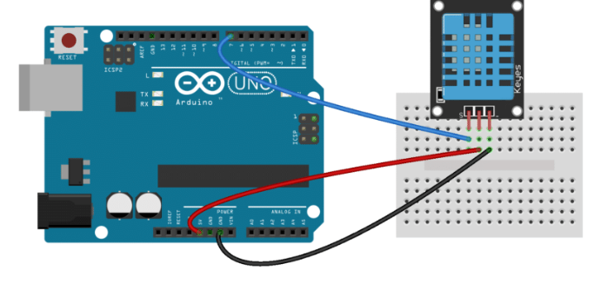
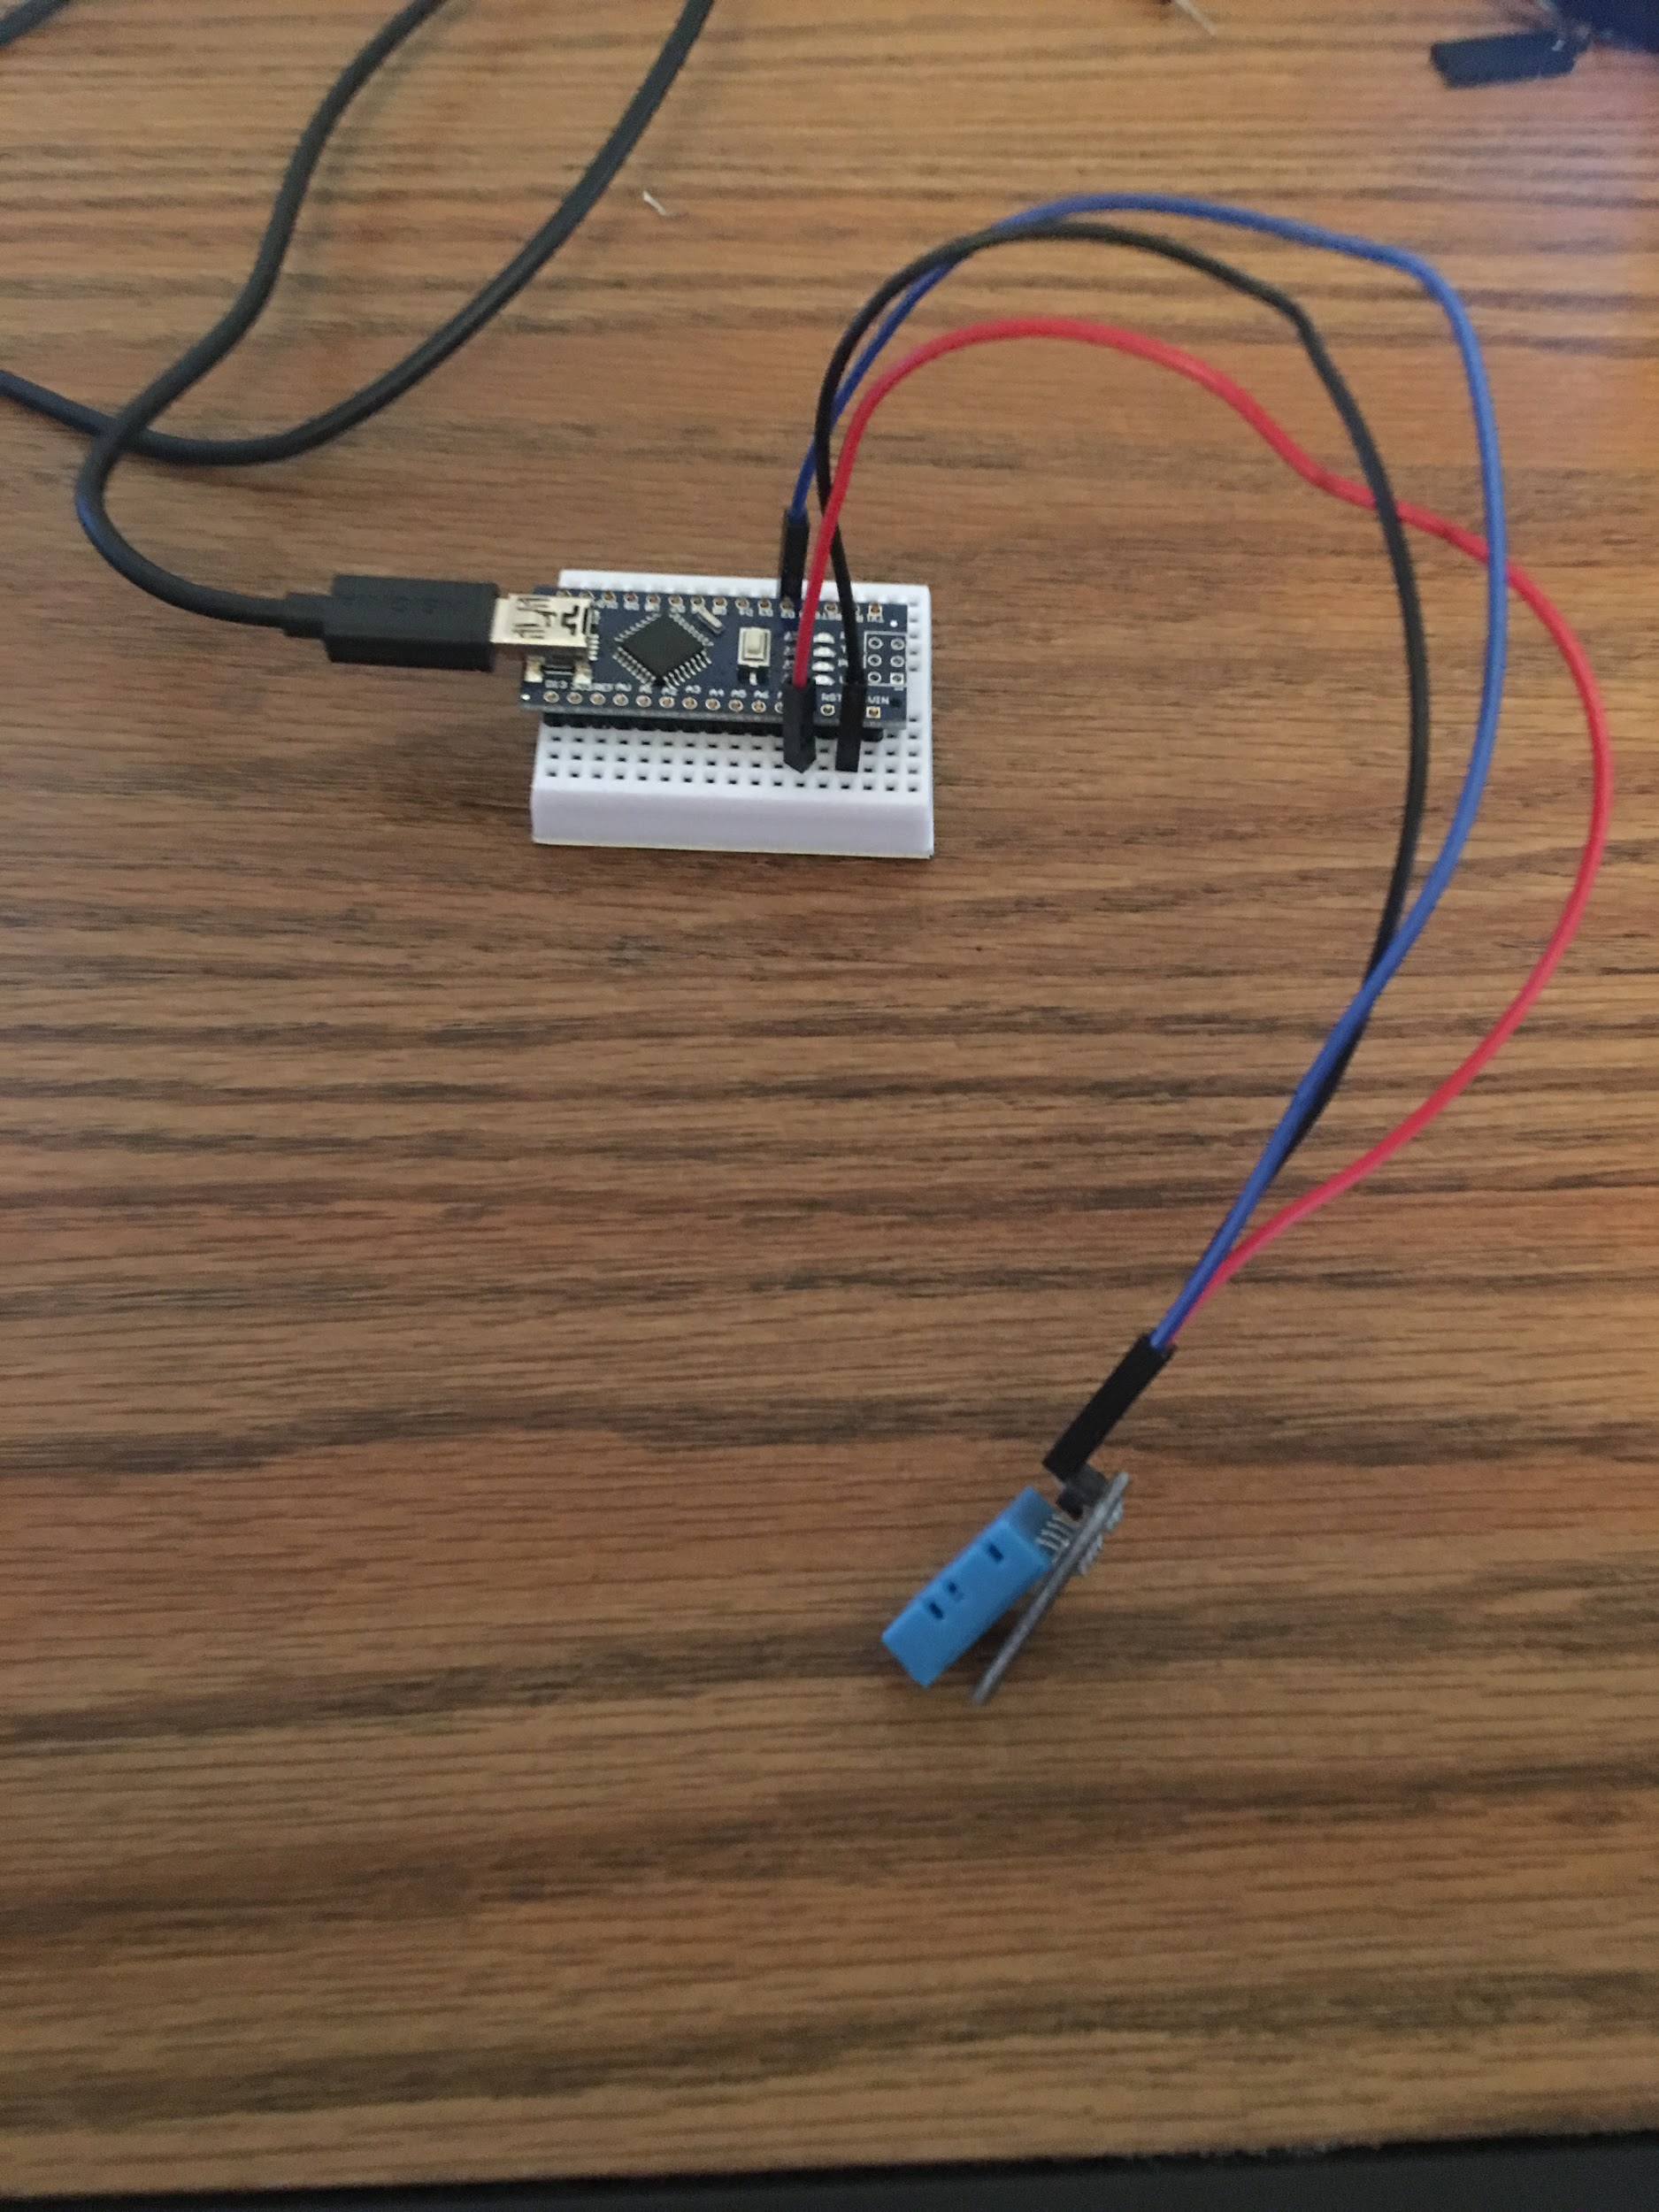
Implementation (Subtask 1.1) Circuit Design and algorithm for temperature Sensor

Slide 14
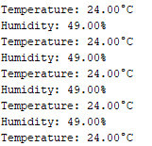
Subtask 1.1 (output)
Output displays both temperature and humidity.
Only temperature is sent to the RF transmitter.

Slide 15
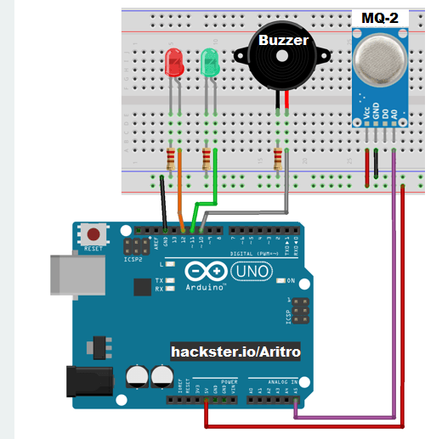
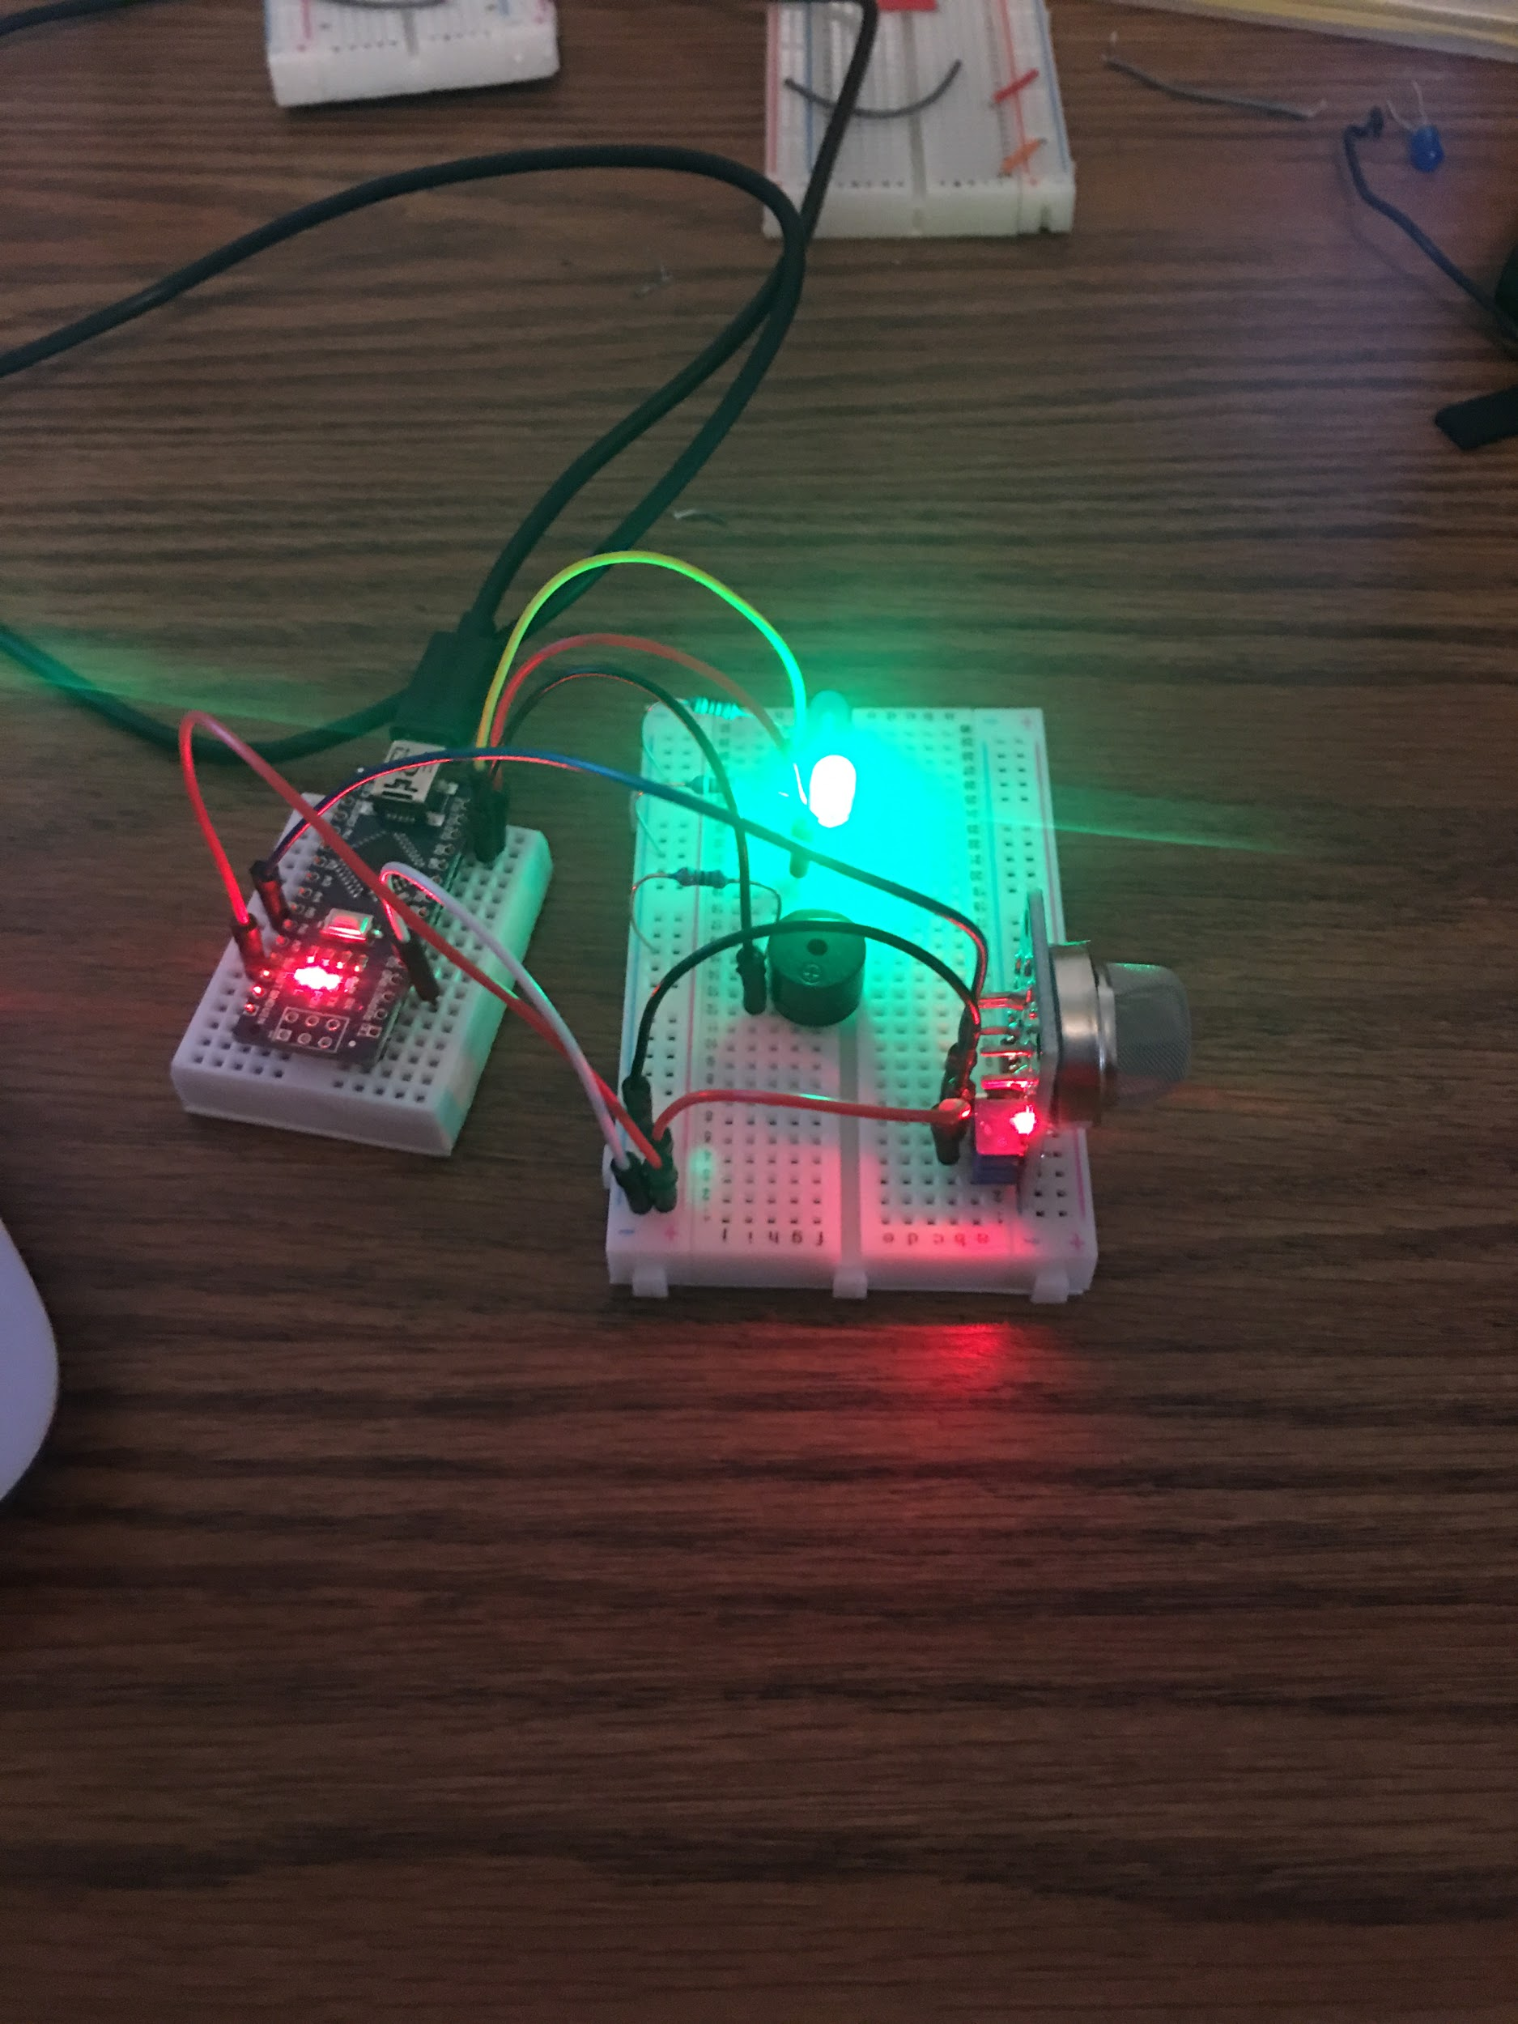
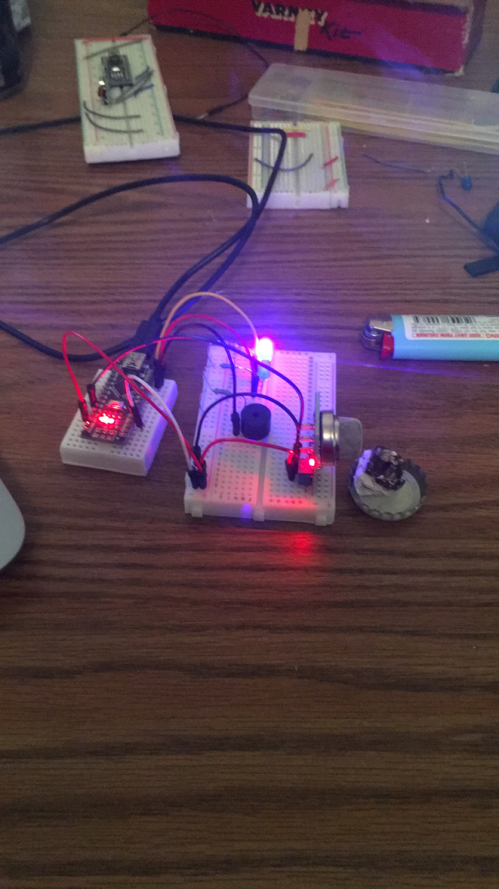
Implementation (Subtask 1.2) Design circuit and algorithm for ionization sensor

Slide 16
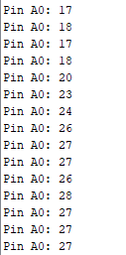
Subtask 1.2 (output)
Output is transmitted via analog pin 0.
Air particulate is measured in ppm (parts per million).
Threshold value set at 20 ppm.

Slide 17
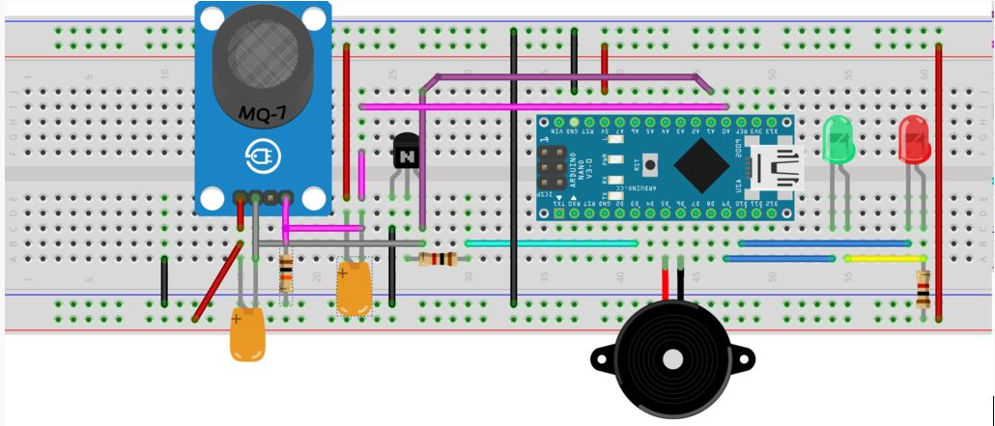
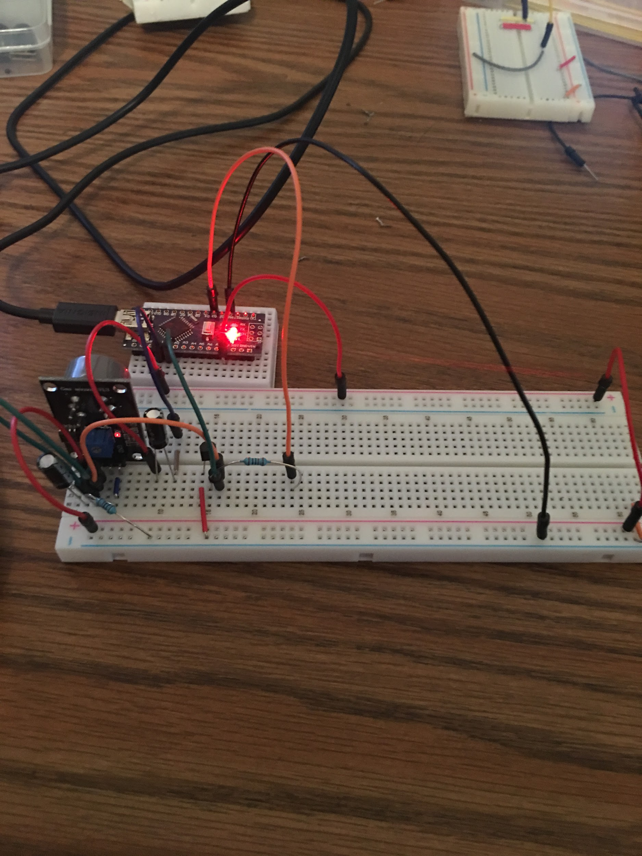
Implementation (Subtask 1.3) Design Circuit and algorithm for CO sensor

Slide 18
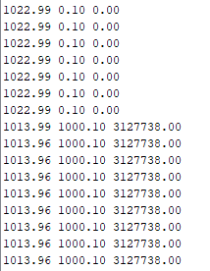
Subtask 1.3 (Output)
CO threshold set to 1500 ppm.
Third column represents CO reading (ppm)

Slide 19
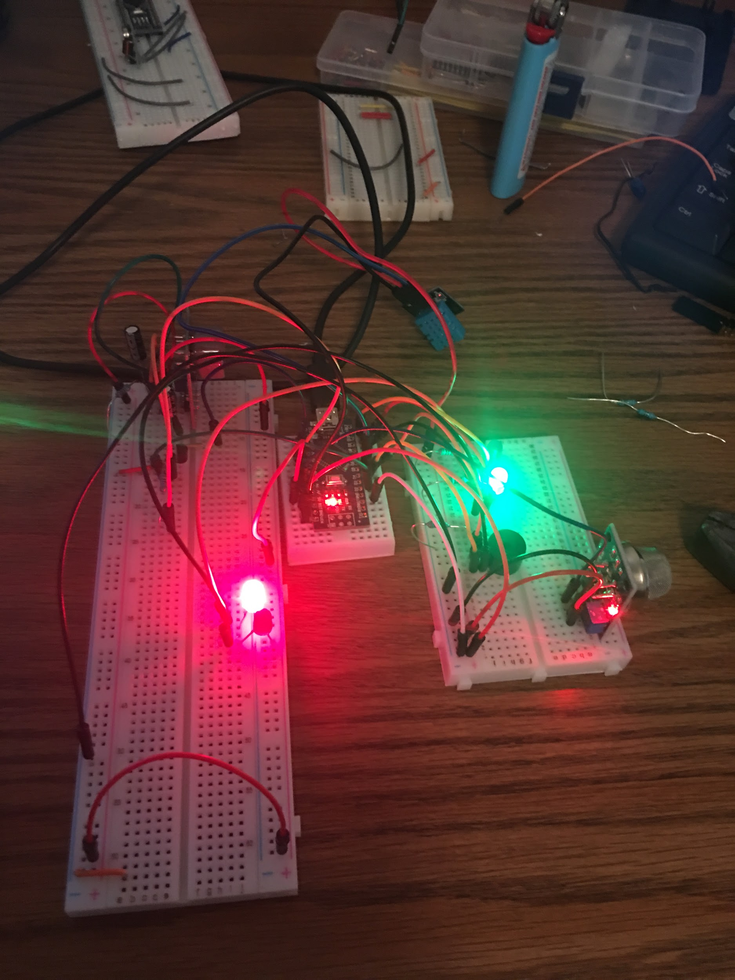
Implementation (subtask 1.4) Interface all sensors with arduino

Slide 20
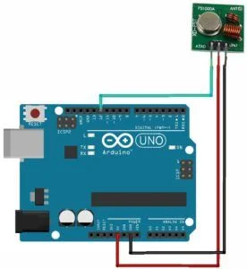
Implementation of task 2.1
This RF module will have an RF Transmitter and an RF Receiver. The transmitter/receiver (Tx/Rx) pair operates at a frequency of 433 MHz. An RF transmitter receives serial data and transmits it wirelessly through RF through its antenna.

Slide 21
Implementation of task 3.1
Owner registers and makes an account. Includes name, email, phone number, username, password, verify password, building address
Design and layout of building
Employee information. Includes name, number

